Slide 1
Demand
Professor Ravi kiran

Slide 2
Demand
  The willingness and ability of buyers to purchase a good or service.
  Demand for a particular product or service represents how much people are willing to purchase at various prices.
  Thus, demand is a relationship between price and quantity, with all other factors remaining constant.
  Demand is represented graphically as a downward sloping curve with price on the vertical axis and quantity on the horizontal axis

Slide 3
Demand
Generally the relationship between price and quantity is negative.
Higher is the price level the lower will be the quantity demanded and, conversely, the lower the price the higher will be the quantity demanded.
Market demand is the sum of the demands of all individuals within the marketplace.

Slide 4
Demand
Demand relates the quantity of a good that consumers would purchase at each of various possible prices, over some period of time.
The ceteris paribus condition means that we look at only one relationship at a time.

Slide 5
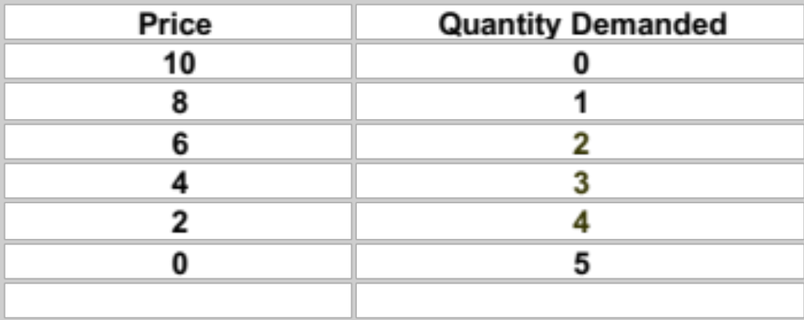
Demand Schedule

Slide 6
Law of demand
Law of Demand states that, all other factors being equal, (Ceteris Paribus) as the price of a good or service increases, consumer demand for the good or service will decrease and vice versa.

Slide 7
THE IMPACT OF A PRICE CHANGE
Economists often separate the impact of a price change into two components:
  the substitution effect; and
  the income effect.

Slide 8
THE IMPACT OF A PRICE CHANGE
The substitution effect involves the substitution of good x₁ for good x₂ or vice-versa due to a change in relative prices of the two goods.
The income effect results from an increase or decrease in the consumer’s real income or purchasing power as a result of the price change.
The sum of these two effects is called the price effect.

Slide 9
THE IMPACT OF A PRICE CHANGE
  If at new prices less income is needed to buy the original bundle then “real income” has increased
  If more income is needed to buy the original bundle then “real income” has decreased

Slide 10
Downward slope of Demand Curve
Most goods are normal (i.e. demand increases with income).
The substitution and income effects reinforce each other when a normal good’s own price changes.
Both the substitution and income effects increase demand when own-price falls, a normal good’s ordinary demand curve slopes downwards.
The “Law” of Downward-Sloping Demand therefore always applies to normal goods.

Slide 11

Income
Price
Prices of other
goods
Determinants of
Demand
Expectations
about future
Number of
Buyers
Supply
Tastes &
Preferences
Quality

Slide 12
Factors Influencing Demand
Price of the commodity:
Price is a very important factor, which influences demand for the commodity.
Generally, demand for the commodity expands when its price falls, in the same way if the price increases, demand for the commodity contracts.
It should be noted that it might not happen, if other things do not remain constant.

Slide 13
Factors Influencing Demand
Income of the consumer:
A consumer’s demand is influenced by the size of his income. With increase in the level of income, there is increase in the demand for goods and services.
A rise in income causes a rise in consumption. As a result, a consumer buys more.
For most of the goods, the income effect is positive.
But for the inferior goods, the income effect is negative.
That means with a rise in income, demand for inferior goods may fall.

Slide 14
Factors Influencing Demand
Changes in the prices of related goods:
Sometimes, the demand for a good might be influenced by prices changes of other goods.
There are two types of related goods.
They are substitutes and complements. Tea and Coffee are good substitutes.
A rise in the price of coffee will increase the demand for tea and vice versa.
Bread and butter are complements.
A fall in the price of bread will increase the demand for butter and vice versa

Slide 15
Factors Influencing Demand
Tastes and preferences of the consumers:
Demand depends on people’s tastes, preferences, habits and social customs.
A change in any of these must bring about a change in demand.
For example, if people develop a taste for tea in place of coffee, the demand for tea will increase and that for coffee will decrease.

Slide 16
Factors Influencing Demand
Change in the distribution of income:
If the distribution of income is unequal, there will be many poor people and few rich people in society.
The level of demand in such a society will be low.
On the other hand, if there is equitable distribution of income, the demand for necessaries commonly consumed by the poor will increase and the demand for luxuries consumed by the rich will decrease.
However, the net effect of an equitable distribution of income is an increase in the level of demand.

Slide 17
Factors Influencing Demand
Price expectations:
Expectations of people regarding the future prices of goods also influence their demand.
If people anticipate a rise in the prices of goods in future due to some reasons, the demand for goods will rise to avoid more prices in future.
Contrarily, if the people expect a fall in price, the demand for the commodity will fall.

Slide 18
Factors Influencing Demand
State of economic activity:
The state of economic activity is major determinant influencing the demand for a commodity.
During the period of boom, prosperity prevails in the economy.
Investment, employment and income increase.
The demand for both capital goods and consumer goods increase. But in period of depression demand declines due to low investment and low income.

Slide 19
Factors Influencing Demand
The level of demand for a commodity is also influenced by other factors like:
  population,
  composition of population,
  taxation policy of the government,
  advertisement,
  natural calamities,
  pattern of saving,
  inventions and discoveries and
  outbreak of war, emergencies, weather,
  technical progress etc.

Slide 20
INFERIOR GOODS
Some goods are (sometimes) inferior (i.e. demand is reduced by higher income).
The substitution and income effects “oppose” each other when an inferior good’s own price changes
The substitution effect is as per usual. But, the income effect is in the opposite direction.

Slide 21
Inferior Goods
In rare cases of extreme inferiority, the income effect may be larger in size than the substitution effect, causing quantity demanded to rise as own price falls.
Such goods are Giffen goods.
Giffen goods are very inferior goods.

Slide 22
Price effect
Normal good
Price increases substitution effect quantity increases
income effect quantity increases
Inferior good
substitution effect quantity increases
income effect quantity decreases

Slide 23
Shifting Demand versus Movements along a Demand Curve
A change in the price of a good causes a change in the quantity demanded, but does not shift demand

Slide 24
Changes in Demand vs. Changes in Quantity Demanded
A price change would change the quantity demanded which involves movement along the demand curve.

Slide 25
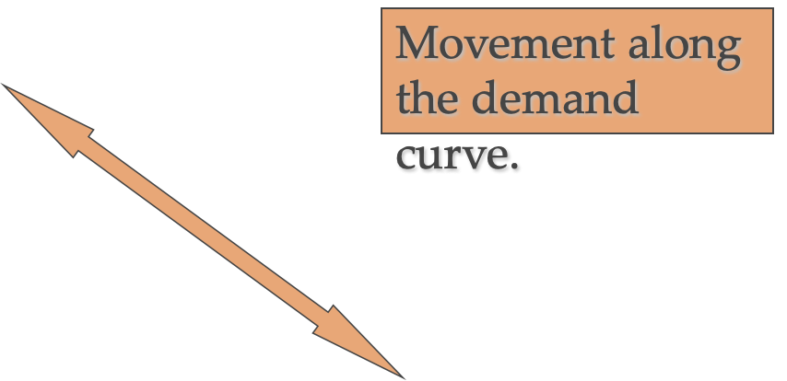
Changes in Demand vs. Changes in Quantity Demanded
Price ($’s)
Decrease
Increase
Demand
Quantity

Slide 26
Factors causing Shift in Demand
Tastes and Preferences
Substitutes and Complements
Income
- Normal vs. Inferior Goods
Population
Price Expectations

Slide 27
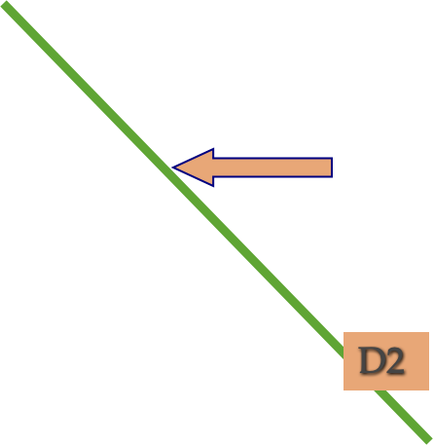
Changes in Demand - Decrease
Demand Shifts LEFT
When:
Prices of substitutes decrease
Prices of complements increase
Normal good-income decreases
Inferior good-income increases
Population decreases
Tastes & preferences turn against the product
Price
D1
Quantity

Slide 28
Changes in Demand - Increase
Demand Shifts RIGHT When:
Prices of substitutes increase
Prices of complements decrease
Normal good-income increases
Inferior good-income decreases
Population increases
Tastes & preferences turn in favor of the product
Price
D2
D1
Quantity

Slide 29

Thank You

